Slide 1
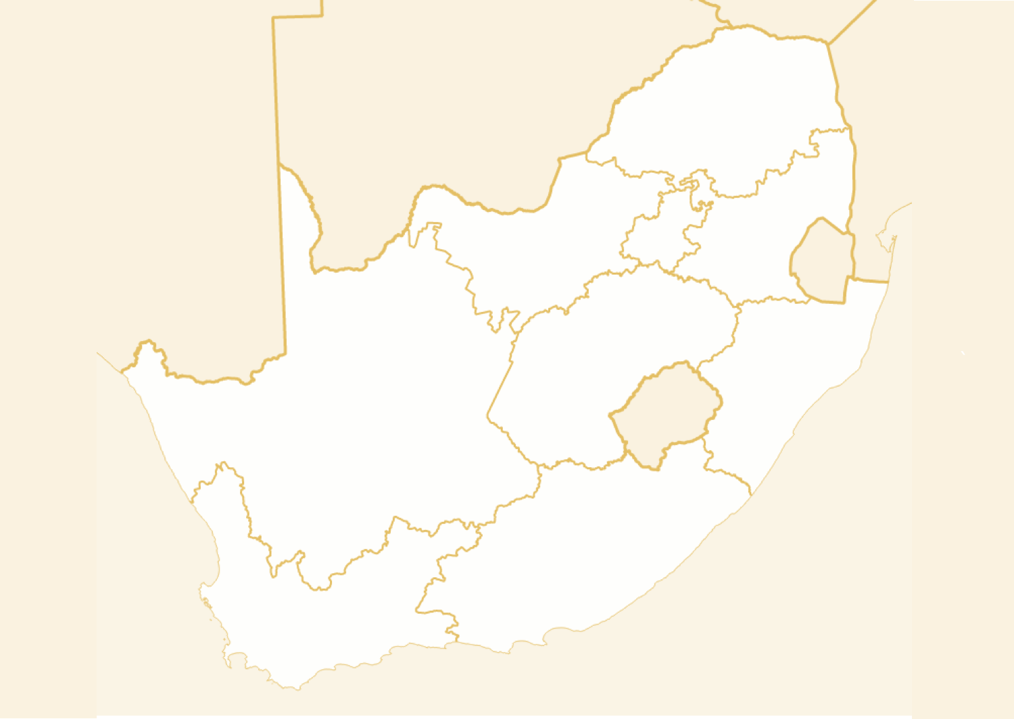
Ethnographic Study for HIV Prevention Reveals a Typology Consisting of Five Distinct Types among South African Adolescents and Young Women
K. Crowley¹, J. Piper², J. Cummins², G. Gao, L. Burn³,
K. Igumbor³, R. Agarwal¹, F. Veronese²
¹University of Maryland Robert H. Smith School of Business, Center for Health Information and Decision Systems, College Park, United States, ²National Institute of Allergy and Infectious Diseases, Division of AIDS, Prevention Science Program, Rockville, United States, ³KantarTNS, Cape Town, South Africa

Slide 2
ABL Contract # (HHSN272201600008I) with NIAID/NIH support.
No conflicts of interest to report.

Slide 3
Prevention: A Priority
1.2 million people aged 10-19 years
1/5th of global population
By 2050, Sub-Saharan Africa (SSA): more adolescents than any other region
Growing population susceptible to infection
Population of adolescents 10-19 years old in millions, by region, 1950-2010
Source: UNICEF, 2012

Slide 4
Outcomes of Recent HIV Prevention Trials in Women
“None of the drug regimens we evaluated reduced the rates of HIV-1 acquisition…. Adherence to study drugs was low.” VOICE Trial (1)
“HIV-1 protection was not observed for women between the ages of 18 and 21 years, and objective markers of adherence were lower in this subgroup than in those older than 21 years.” ASPIRE Trial (2)
Montgomery et al. (2017) AIDS Behav.
Baeten at al. (2016) NEJM.

Slide 5
Research Objectives and Methods
Promoting HIV Prevention Among Low Income Women in South Africa: Behavioral, sociological and product market opportunities and challenges
Desk Research & Expert IDIs
Ethnography
Major metro areas focus: Johannesburg, Durban and Cape Town
Urban and Peri-urban respondents LSM 4-7
Young black females, ages 14-25, with subgroups 14-17 and 18-25 years old

Slide 6
Qualitative Data
Depthnographies
Auto
Ethnography
Hostess home groups
Influencer IDIs
Expert IDIs
11 subject matter experts
32 young women for a period of 3 days each
8 digitally savvy participants
Friendship quads with 12 participants
11 interviews with key influencers
6 IDIs one-on-one, and then paired with partners
IDIs (Bolt-on)

Slide 7
Differentiated Segments
PRIVILEGED
The Good
Girl
Liberated
Survivalist
Thriving
Protection
Savvy
Finding
LOW RISK
HIGH RISK
Striving
Surviving
Responsible Mother
Gender
Prisoner
SURVIVAL

Slide 8
Distinguishing Characteristics (1)
 | THE GOOD GIRL | RESPONSIBLE MOTHER | PROTECTION SAVVY | LIBERATED SURVIVALIST | GENDER PRISONER
DEFINING CHARACTERISTICS | Innocent, religious, conservative, obedient, sheltered, abstinence. | Innocent, isolated, down-to-earth, responsible, home-body, committed relationship, risk-averse. | Independent, careful, risk-averse, feminist, selective, informed. | Socialite, Trendy, confident, risky-sex, Party girl | Powerless, exploited, irresponsible, unstable home, high risk
Sexual Health and Partners
Level of Vulnerability/ Risk | Lowest | Low | Moderate | High | Highest
Sexual Activity Frequency | Not sexually active- virgins | Occasional | Frequent | Frequent | Frequent
Number of Partners | n/a | None or One | Multiple | Multiple | Multiple
Sexual Partner Type | None | Committed long term relationship | Boyfriends- long-term & Flings in-between boyfriends | Blesser/ Boyfriend & Flings/ One-night stands | (Blesser)/ Boyfriend & Flings/ One-night stands

Slide 9
Distinguishing Characteristics (2)
 | THE GOOD GIRL | RESPONSIBLE MOTHER | PROTECTION SAVVY | LIBERATED SURVIVALIST | GENDER PRISONER
Sexual Health Products
Use condoms | n/a | Always | Frequently | Sometimes | Hardly ever
Power over condom use | n/a | Highest | High-moderate | Moderate | Low(est)
Social and Gender Influences
Media Sexualisation Influence | Moderate | Low | Moderate | High | Low
Sexual Autonomy | None- n/a | Moderate- High | High | Moderate | None
Breaking free from cultural and social patriarchy | Somewhat- too innocent to be able to break free fully yet | Somewhat- is learning to protect herself and have a voice in her relationships | Yes- has a voice and know-how to say what she wants in a relationship | Somewhat- sexual confidence that has become sexualised | No- conforms to gender roles, has little power

Slide 10
Distinguishing Characteristics (3)
 | THE GOOD GIRL | RESPONSIBLE MOTHER | PROTECTION SAVVY | LIBERATED SURVIVALIST | GENDER PRISONER
Economic Conditions
General Socio-economic status | Privileged | Moderate | Moderate | Privileged | Survival
Economic freedom | Nearing | Somewhat- able to pay for most needs | Somewhat- able to pay for most needs | Nearing | No- struggling to survive
Education
Highest education completed | University/ College | College/ Diploma | University/ College/ Diploma | University/ College | High School drop-out
Parent’s education status | Tertiary Graduate | High School & Self-taught/-made | High School & Self-taught/-made | Tertiary Graduate | High School drop-out

Slide 11
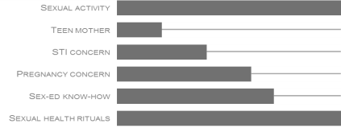
Liberated Survivalist
Confident material girl is her sexual currency
Psychographic Profile
Home Life
She is confident in her sexuality and uses being a woman to her advantage. She is always on the forefront of the latest fashion trend, and will be out and about showing off her latest outfit or expensive accessory.
She loves to party, socialise and have a good time; as long as she is in the right crowd who will give her the appreciation she feels she deserves.
Her household life is not always stable, things may not be what they seem. She is often out and about socialising, and so spends little time at home.
To her parents she is a good girl, but they don’t know what she gets up to. Her parents are not too strict, so she takes liberties as often as possible.
Relationship Status
Critical Life Events
She has multiple sexual partners, some are flings or short term relationships.
Of all the typologies she is most likely to have a sugar daddy or ‘Blesser’ who expects sex from her in exchange for financial security (education) or gifts.
Though she is confident, she allows her partners to dictate their protection preferences. As a precaution, she will always be on ‘the pill’ to prevent unwanted pregnancies.
When she found her confidence and power as a woman during one of her sexual encounters. This has opened up a world of finding social acceptance through engaging in sex.

Slide 12
Liberated Survivalist
Multiple and impulsive sexual encounters makes her vulnerable in-the-moment
Vulnerabilities
Multiple casual partners and impulsive decisions increase her risk of contracting a STI.
Partners preferring not to use condoms. She needs a back up option that does not impede his pleasure.
Forgetting to take the pill/ go to clinic for her injection.
Empower her with a covert STI prevention product
>
Relevant Initiatives
Communication & Messaging
Participation in sexual health activations
Key gate keepers: clinics, education institutions, Sexual Health NGO’s/ Organisations/ Initiatives
Clubs/ tavern dispensers
Positioning Messages:
Protect yourself
Have back-up protection on-hand
Responsible but fun sexual encounters
Product Packaging:
Trendy, modern, feminine
Content creator and vocal participator

Slide 13
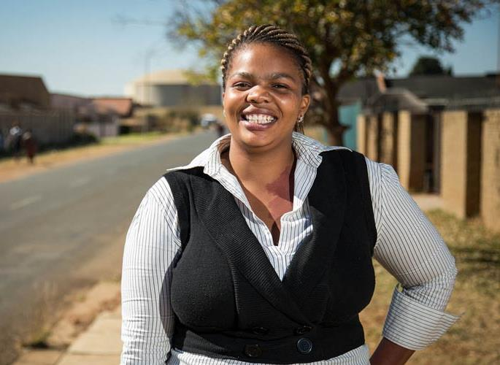
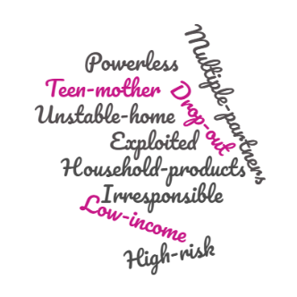
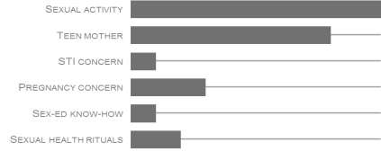
Gender Prisoner
Economic instability leaves her powerless
Psychographic Profile
Home Life
She conforms to cultural and social gender roles, and has little power over her life situation. Her family does not have the financial capability for her to attend a good school, and so she feels trapped in her situation.
She seeks social acceptance through sexual encounters which earns her a place in her peer group.
Typically lives in an unstable home with limited financial security. She has many financial responsibilities and takes on the role as surrogate mother to her siblings/ cousins. Her parents are not strict and often not at home to keep an eye on her, so she has free reign to do as she wishes.
Critical Life Events
Relationship Status
Her economic instability has thrust her into a difficult and powerless situation. With more than one child, she is overwhelmed by responsibility which she tries to escape by partying over the weekend. Since she fell pregnant she dropped out of school, and has few opportunities to improve her life.
Multiple sexual partners, typically has more than one child and fell pregnant when she was a teenager.
Often her sexual relationships are abusive, and she has very little say in protection or prevention.
It is expected of her to ensure that her partner is satisfied according to his preferences.

Slide 14
Gender Prisoner
Her lack of know-how and power makes her the most vulnerable
Vulnerabilities
Lack of sexual health protection/ prevention knowledge means she has learnt through experience and she is unprepared for the unexpected encounter.
Sexual healthcare and clinics are inaccessible or struggles to find time to make routine visits.
Multiple partners and unprotected sex.
Empower her with easily accessible ‘covert’ protection/ prevention products
>
Relevant Initiatives
Communication & Messaging
Mobile clinics/ education activations
Key Gate keepers: church, township schools, township/ peri-urban/ rural clinics
Shebeen/ tavern dispensers
Messaging:
Protection without ‘him’ knowing
Packaging:
Not overtly a sexual health product- help her protect herself without her partner knowing
Observer rather than a participator

Slide 15
Conclusions
The limitations of a “one-size fits all” approach
Differing motivations, beliefs, and socio-economic conditions
The central importance of the “socio-cultural” context
Product conceptualization and design
Promotion and marketing strategies

Slide 16
Thank You.
Contact: chids@rhsmith.umd.edu

